Slide 1


Drowsiness Detection for Truck Driver
Group 3:
Abhijeet Chaudhari
Harshilkumar Patel
Kishankumar Patel
Rishav Rana

Slide 2
Problem Statement
Drowsiness or fatigue is a common issue that can affect any driver, particularly on long trips, at night, or in the early morning.
Drowsy driving is the risky combination of driving while tired. This usually occurs when a driver has not gotten enough sleep, but it can also occur as a result of untreated sleep disorders or shift work.
The project aims at detecting drowsiness while driving to alert the driver at the right time to prevent any mishappening.
A drowsiness detection system's goal is to reduce accidents caused by drowsy driving and promote road safety. It is a must-have for long-haul truck drivers, shift workers, and others who drive for long periods of time and are prone to drowsiness.

Slide 3
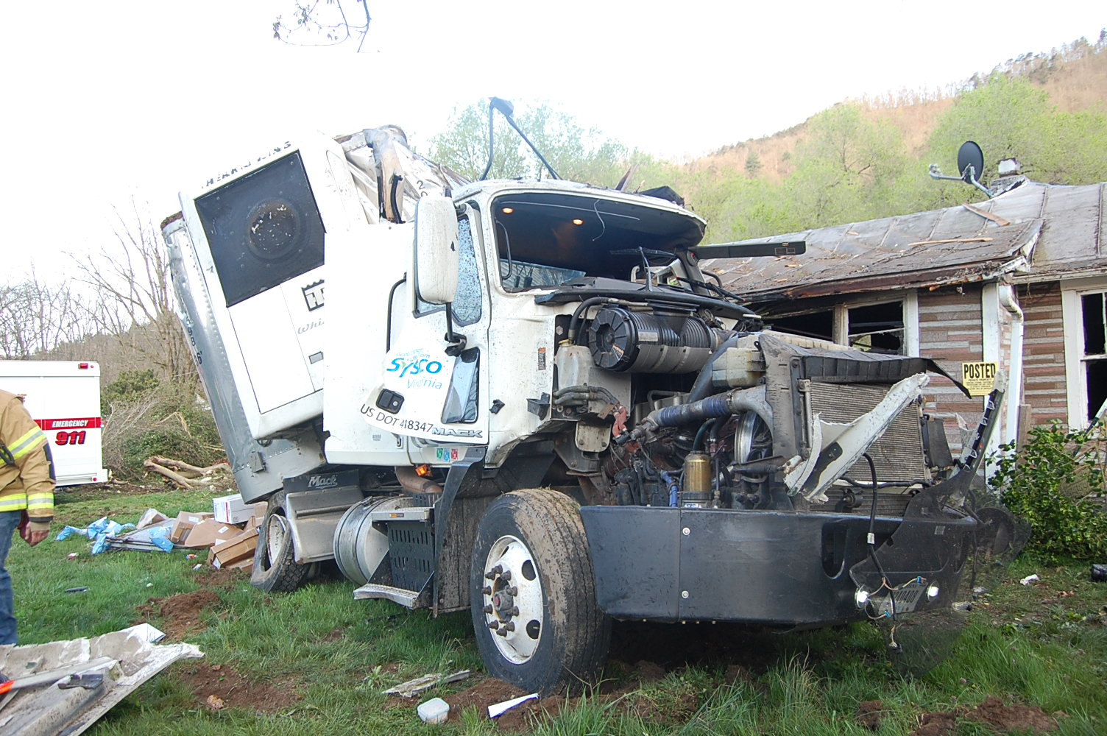
Stats and Facts
From year 1999-2020, there were approximately 326,000 Truck accidents.
According to the Centers for Disease Control and Prevention, about 1 in 25 adult drivers report having fallen asleep while driving.
According to the National Highway Traffic Safety Administration, 100,000 police-reported crashes each year are caused primarily by drowsy driving, resulting in more than 71,000 injuries and $12.5 million in monetary losses.
We analyzed the data from National Collision Data and created the dashboard representing few of the above stats.
Dataset link - https://wwwapps2.tc.gc.ca/saf-sec-sur/7/ncdb-bndc/p.aspx?l=en

Slide 4
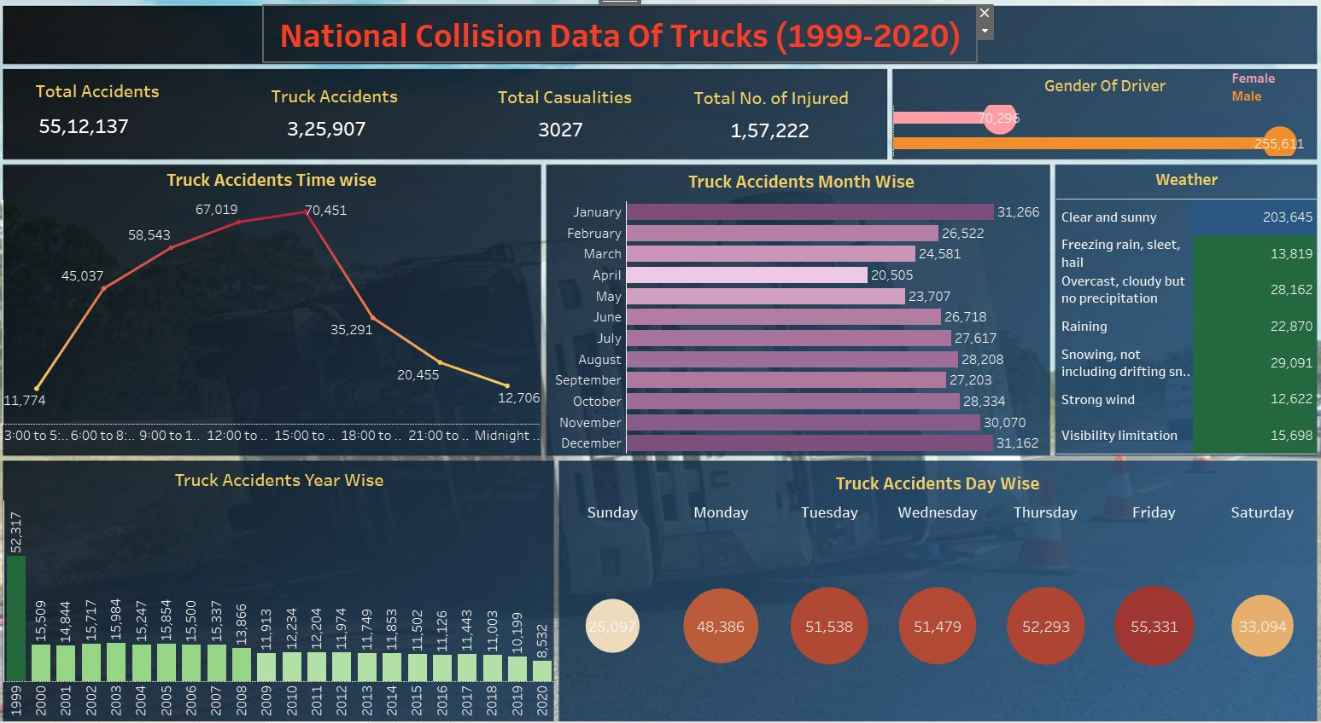

Slide 5
How can we detect drowsiness?
Instead of trying to determine “Eye blinks," we will be more focused in observing whether the eyes are closed, or half closed.
By using powerful libraries like OpenCV, Dlib and MediaPipe we'll use the observation that "Our eyes close when driver feels sleepy, and half closed when he is drowsy.”
The Eye Aspect Ratio (EAR) is the key algorithm that helps determine whether the eyes are closed.

Slide 6
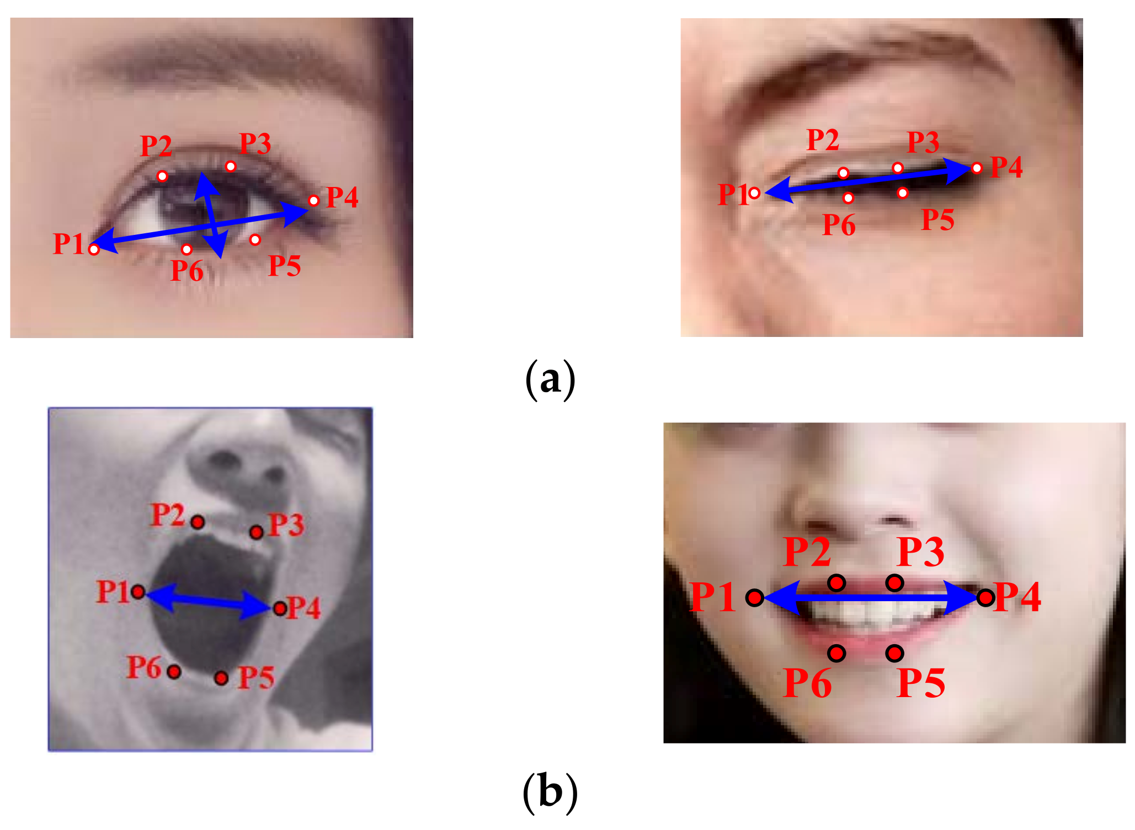
The Eye and Mouth Aspect Ratio Technique
Eye aspect ratio and Mouth aspect ratio are important features used in drowsiness detection algorithms to monitor and analyze facial expressions and movements.
Eye Aspect Ratio is a measurement used in drowsiness detection systems to determine the level of eye closure or blink frequency.
EAR is calculated by measuring the ratio of the vertical eye landmarks to the horizontal eye landmarks, usually using facial landmark detection algorithms.
Mouth Aspect Ratio is another measurement used in drowsiness detection systems to assess the state of the mouth, particularly related to yawning.
MAR is calculated by measuring the ratio of vertical mouth landmarks to horizontal mouth landmarks.

Slide 7
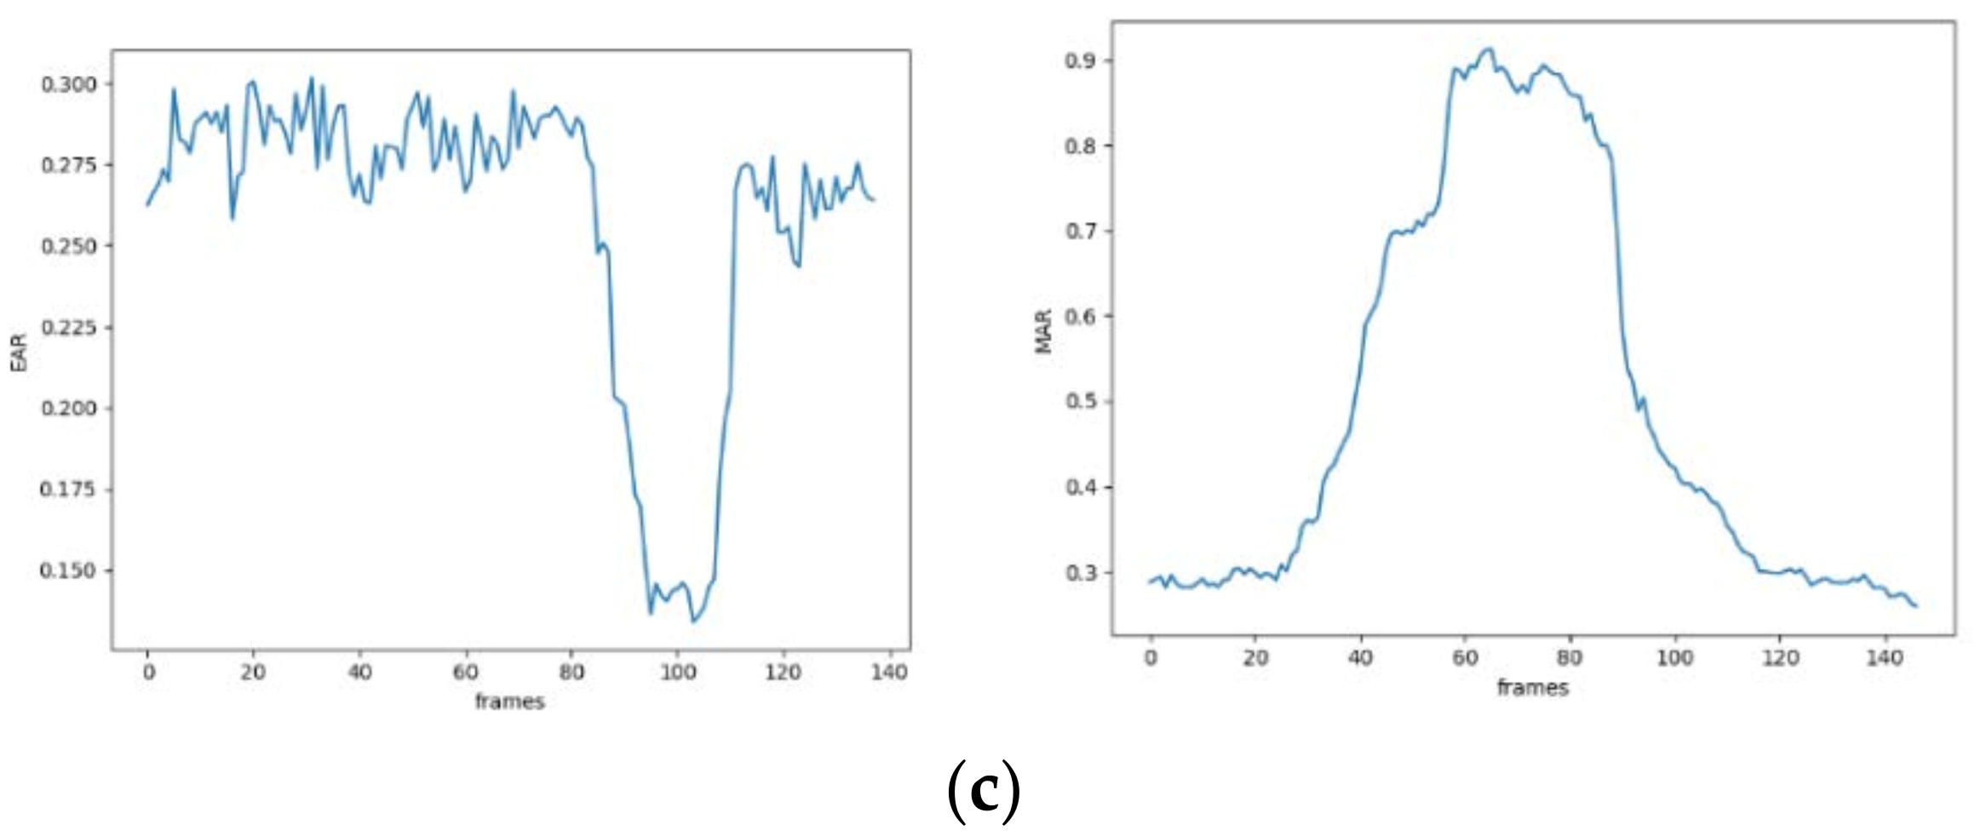
The Eye and Mouth Aspect Ratio Technique
The two diagrams correspond to the change of the MAR curve in yawning state and the EAR curve in the one eye closing process, respectively.
The EAR value drops rapidly to close to zero, and then rises rapidly, representing that the driver blinks once. When the eyes of the driver are open, the EAR is over 0.2, or when the EAR is less than 0.2, it means that the eyes of the driver closed due to dozing.
When the driver yawns, the wider the mouth opens, the greater the MAR value, which determines that the driver yawns.
According to the experimental curve, when the driver’s mouth yawns, the MAR value is more than 0.60. Therefore, the values of EAR/MAR can be adopted to detect whether the driver is fatigue driving.

Slide 8
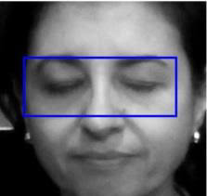
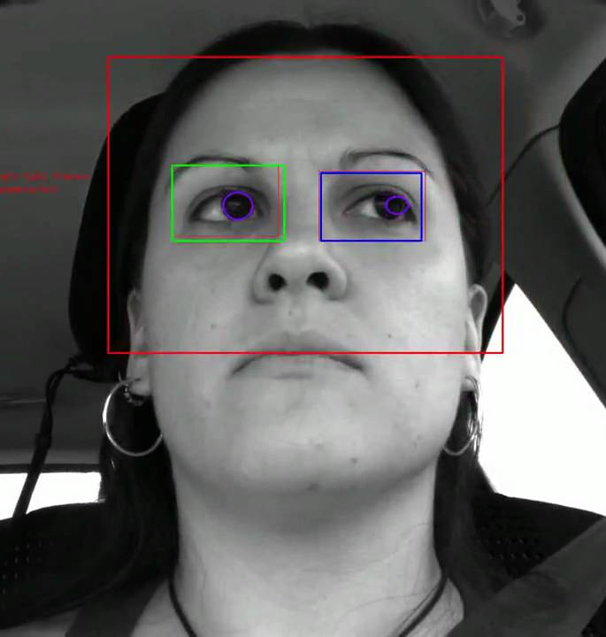
Dataset Collection
We will be using our own images and live video streams that will capture frames and these frames will be used to predict the drowsiness in truck driver by using various models and libraries.

Slide 9

How do we solve this problem ?
Using Machine Learning Model and libraries like:
CNN Model
OpenCV
Dlib
Mediapipe
FaceMesh

Slide 10
Libraries and Modules used:
OpenCV : OpenCV is a well-known open-source library that offers many tools and functions for processing images and videos. It provides a wide range of features for feature recognition, computer vision techniques, and picture editing.
Dlib : It provides reliable 68 facial landmark detection, which is essential. It enables precise tracking of facial expressions and eye movements by recognizing important face landmarks including the eyes and lips. This knowledge is essential for identifying drowsy symptoms.
MediaPipe: It include modules like FaceMesh, which, in conjunction with other features like position estimation and gesture recognition, can be used for sleep detection systems. FaceMesh also can monitor facial landmarks.
Facemesh : It offers a rich network of 468 facial landmarks, such as the corners and lids of the eyes. Also, it makes it possible to precisely track eye movements and identify blinks.

Slide 11
Results
We used deep learning models like Convolutional Neural Networks (CNNs) and Open CV libraries for the detection of drowsiness.
CNN models take photos as input and automatically learn to extract key information. For input we have used the dataset from Kaggle to train the model. In model building we used layers like Sequential , Conv2D , Maxpooling2D and dense.
Focusing on the Open - Closed Eye and Yawn – No Yawn dataset, and we achieved the accuracy of 90.68% while predicting the drowsiness of driver.
We worked on another model using OpenCV and Dlib libraries where we were able to generalize the drowsiness detection using the live webcam which is quite accurate.
We worked on 3rd model where we used MediaPipe Library for detection which does have more capability in detecting drowsiness for it includes FaceMesh Modules and we were able to get accurate Open and Closed Eye Detection.

Slide 12
Next Steps
We need to work on detection of yawning and no yawning. We would be focusing on determining the nodding aswell.
Also, we will add the alert sound if driver is detected drowsy for 2 continuous seconds, that will make alert sound.
And final step are we want to deploy our model to streamlit app. Streamlit is a free and open-source framework to rapidly build and share beautiful machine learning and data science web apps.

Slide 13
Ethical Concerns
Privacy: Systems for detecting drowsiness gather sensitive information, including physiological signs and facial expressions, which could be used to learn about a person's health, way of life, or habits. This information runs the danger of being abused or revealed without permission, which would be bad for the person's privacy.
Bias: Models won't be accurate or that they'll yield biased results.
Reliability: Systems for detecting drowsiness are intended to make decisions based on data, and there is a chance that these conclusions may be harmful or wrong.
False Positives: Drowsiness detection systems using machine learning algorithms may produce false positives, which can cause drivers to take unnecessary breaks or reduce their productivity.

Slide 14
Benefits
Increased safety:
Drowsy driving can lead to accidents and mistakes. Early detection of drowsiness can help prevent accidents and ensure the safety of individuals.
01
Improved productivity:
When individuals are alert and awake, they are more productive and efficient in their work. Drowsiness detection can help ensure that individuals are alert and performing at their best.
02
Early intervention:
Early detection of drowsiness can allow for early intervention, such as taking a break or resting, to prevent further fatigue and drowsiness.
03
Cost-effective:
Drowsiness detection using deep learning can be cost-effective compared to traditional methods such as hiring a dedicated observer or using expensive equipment.
04

Slide 15
Conclusion
A machine learning-based drowsiness detection system is a promising solution for reducing the risk of accidents caused by driver fatigue.
The ml-based drowsiness detection system has several advantages over traditional methods, including its high accuracy, non-invasiveness, and real-time detection.
The system have potential to significantly improve road safety and reduce the number of accidents caused by fatigue driving

Slide 16
Thank You

